Slide 1


Sustainable Research Practice: an introduction
September 2025
Notes:
Welcome to today’s session.

Slide 2
Content
Learning Outcomes
Introduction to Sustainability and Sustainability at Lancaster
Sustainable Research Practices
Scenarios
Share and seek
Summary and evaluation
Further reading and resources
Post training activities
Notes:
There is so much to talk about with the topic of sustainability. This training serves as an introduction to start the conversation in your research and encourage you to think about what actions you can take in your research practice. An individual action may seem small, but if we all do something it adds up to something big. Sustainable research practice in some cases can save money and introduce health and safety improvements.

Slide 3
Learning Outcomes
This training has been designed to achieve three learning outcomes:
Develop a broader understanding of sustainability in research practice
Identify and apply opportunities to improve sustainable research practice
Identify opportunities to engage and advocate for sustainable research practice in your context
Notes:
The purpose of this training is to promote thinking about the different ways that sustainability can be embedded into research practice, and how you can share examples of good practice and seek ideas to address specific issues.

Slide 4




Development of this resource
This resource was developed in 2025 by members of the Reimagining Research Practice project, funded by the Wellcome Trust, in collaboration with the Lancaster University Sustainability Team.
Additionally, conversations with members of the university provided useful insights into sustainability within teaching, operations and research.
Navigation of training and signposting
For the training to be concise, not all slides are shown, but the slides will be made available after the session.
Further resources and additional activities are provided towards the end of the slide deck.
Placeholder for Creative Commons information
Funded by Wellcome
Notes:
This resource was prepared in collaboration with the central Sustainability Team, as well as and staff and postgraduate students from across the university.
Creative Commons information to be added.

Slide 5
(Re) Defining Sustainability (1)
The commonly used definition of Sustainable Development is:
“Development which meets the needs of the present without compromising the ability of future generations to meet their own needs” (Brundtland, 1987)
Put another way, Sustainability is about the planet’s ability to meet all life on Earth’s needs now, and in the future.

Slide 6
(Re) Defining Sustainability (2)
Sustainability and Sustainable Development are often used interchangeably. However, it is easier to think of them as:
Sustainability (the what) – a point on the horizon we are aiming for.
Sustainable Development (the how) – what decisions we make now to move us towards becoming sustainable.

Slide 7
(Re) Defining Sustainability (3)
You may be used to hearing about environmental topics which are often linked to Sustainability; however, Sustainability is everywhere - we’re just not very good at seeing or understanding that.
To help us understand what Sustainability really means and how far it reaches into our daily lives, let’s look at the Sustainable Development Goals (SDGs):
https://www.youtube.com/watch?v=qfOgdj4Okdw
Notes:
Sustainability is everywhere. The Sustainable Development Goals (SDGs) are one way to review its’ reach. There is a video link here that you may wish to watch later.

Slide 8
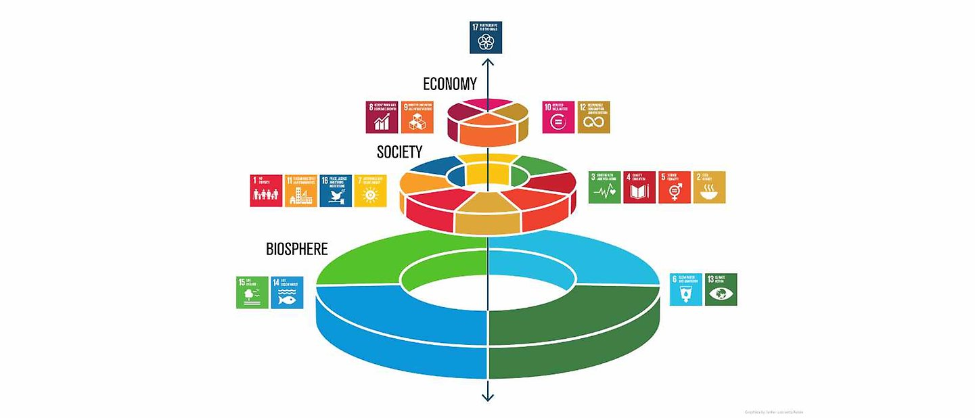
(Re) Defining Sustainability (4)
Even though the environment is what is most commonly thought of, only four of the UN’s Sustainable Development Goals (SDGs) are about our natural environment.
These are: SDG 6, SDG 13, SDG 14 and SDG 15.
These form the bottom layer of the tiered structure.
Developed by the Stockholm Resilience Centre, this helpfully illustrates that human economic and social activity are only possible because of the Earth’s natural systems.
Your research will contribute to the achievement of the SDGs.
Azote for Stockholm Resilience Centre, Stockholm University CC BY-ND 3.0
Notes:
Of the 17 SDGs. There are 4 about the natural environment – located in the bottom tier of the figure.
Human and economic activities are then located above these, demonstrating their reliance on Earth’s natural systems.
Directly or indirectly. In what you research or how you carry out your research.
Facilitators notes: Activity: Mapping research to SDGs (could use online toolkit, download the Excel spreadsheet, or do it on at whiteboard/visualiser)
Map your Research | University College Cork

Slide 9
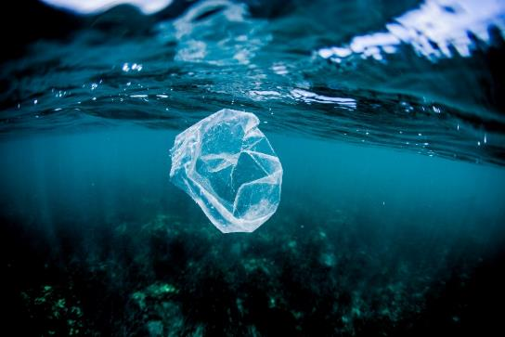
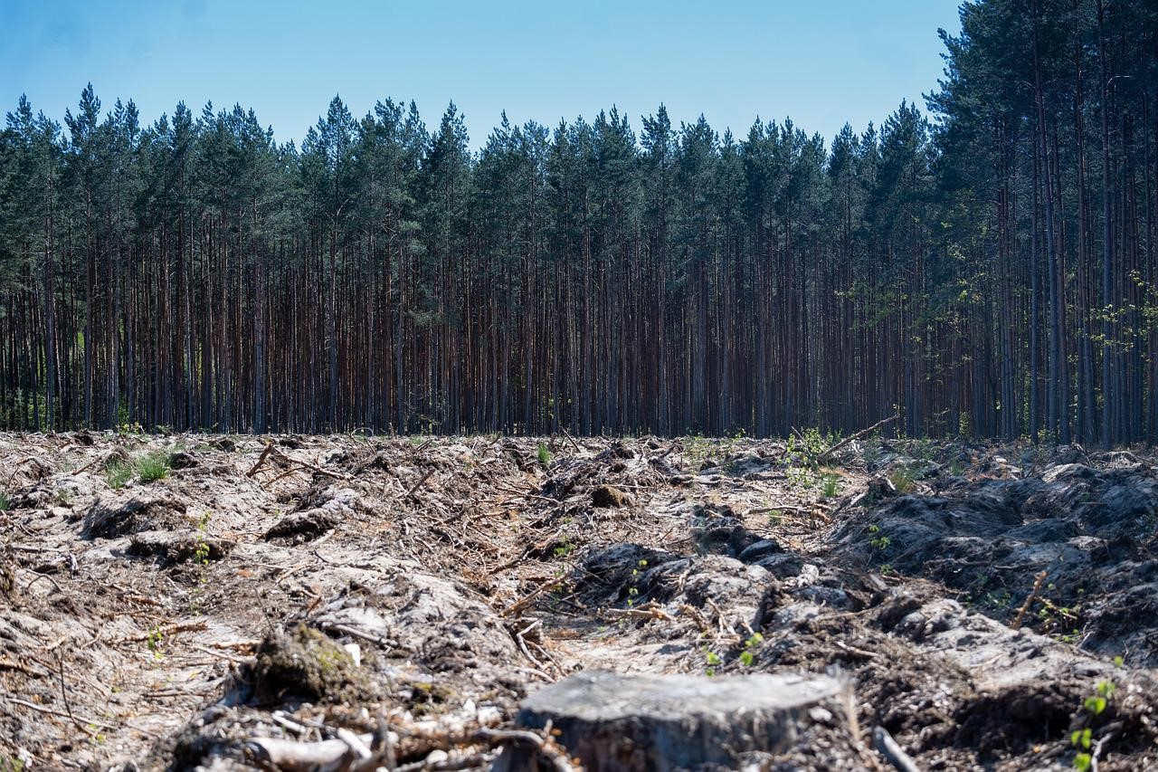
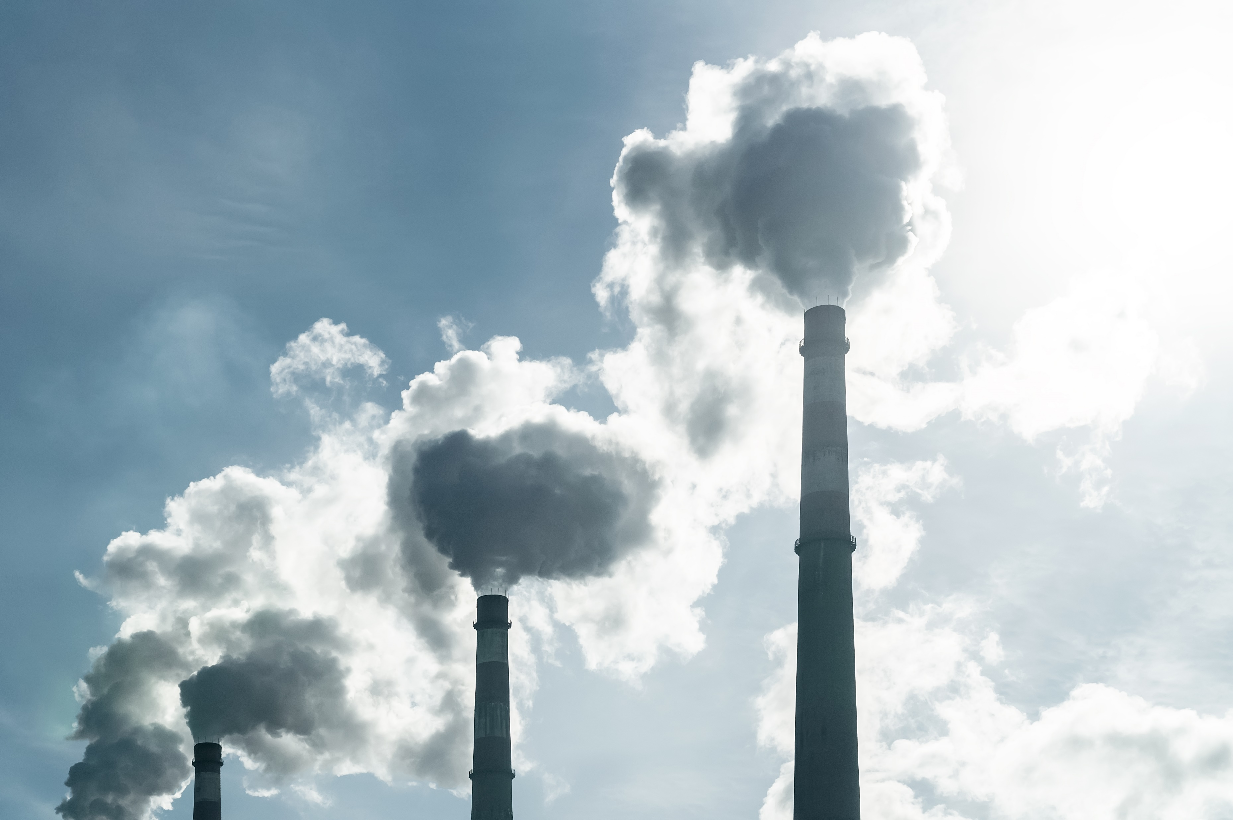
Environmental Degradation
"The reduction of the capacity of the environment to meet social and ecological objectives, and needs." (UNESCO 2010)
Notes:
A reason to care about environmental sustainability is environmental degradation.
This includes air and water quality, and biodiversity and plant health.

Slide 10
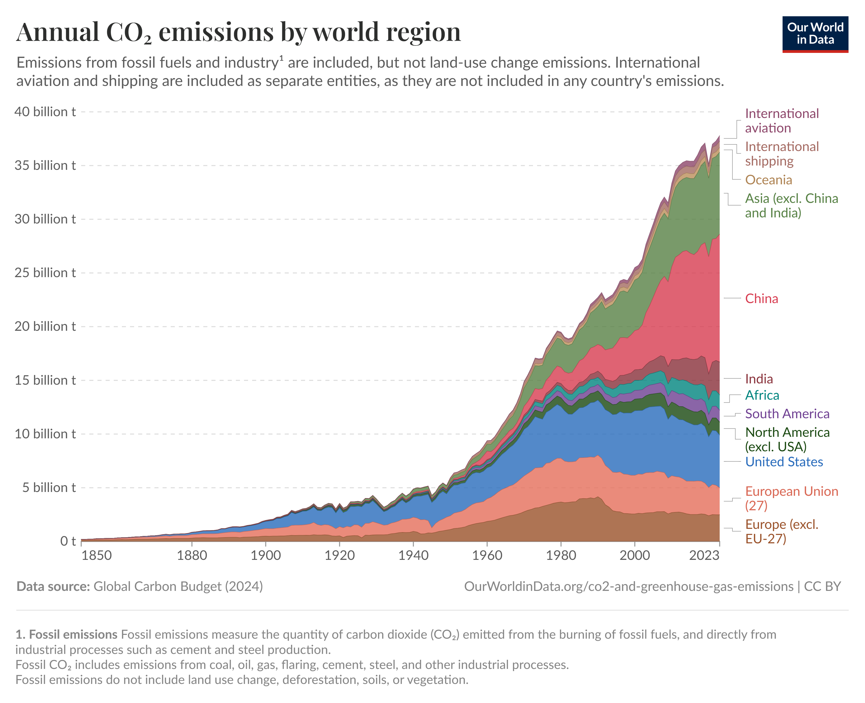
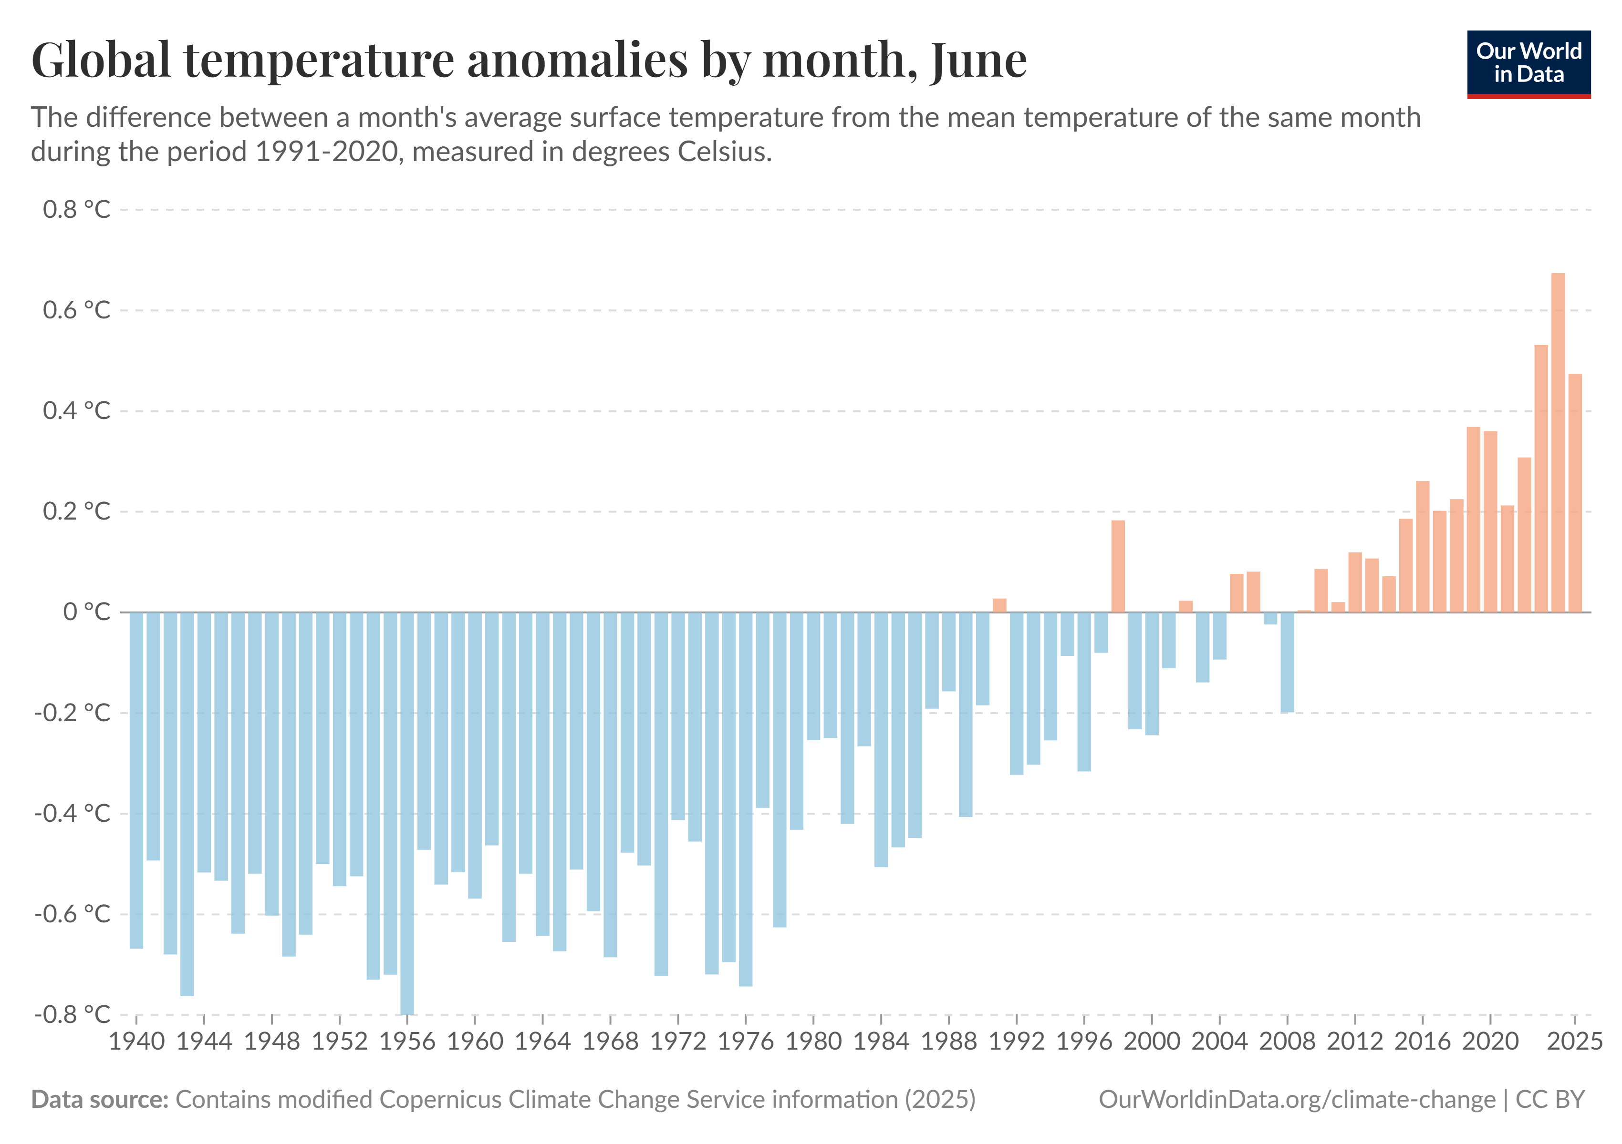
Greenhouse gases
When greenhouse gases (GHGs) such as carbon dioxide, methane, and nitrous oxide, are in the atmosphere they trap heat causing climate change.
Climate Change - Our World in Data
CO₂ and Greenhouse Gas Emissions - Our World in Data
Notes:
One environmental impact under the spotlight is climate change caused by a build up of greenhouse gases. We will look more at carbon emissions in a few slides time.

Slide 11
(Re) Defining Sustainability (5)
The nested diagram, shows the relationship between the commonly used three pillars of Sustainability – economy, society and environment.
Reinforces that just talking about Sustainability in environmental terms is missing a huge opportunity to better understand our much broader and longer term personal/ organisational impact.
We will now look at Sustainability here at Lancaster University.
Sustainability - Lancaster University
Environment
Society
Economy

Slide 12

Sustainability at Lancaster (1)
It is important to think broadly about the university’s sphere of influence, and how this affects our sustainability as an organisation.
We are the largest employer in the Lancaster district
With approximately 3200 staff, and 15,500 students > 6250 on campus residents and a further 7400 in Lancaster city.
Our 100+ buildings cover an area of 331,228 m²
Our total estate covers 2.48 km²
An annual turnover of approximately £350 million
With five international partnership campuses
And 170,000 alumni in 190 countries
Notes:
The university’s sphere of influence extends beyond the Bailrigg campus.

Slide 13
Sustainability at Lancaster (2)
Lancaster University voluntarily produces an annual report on our performance against each of the UN Sustainable Development Goals (SDGs).
The report is structured around our four key impact areas for each SDG:
Research
Teaching
Campus life
Outreach and engagement
This is a great resource to use if you’re unsure about how a particular goal is relevant to the University. It is also another reminder about why we should avoid thinking about Sustainability in just environmental terms.
Notes:
The university produces an annual report, which provides a performance review for four key operational areas: research, teaching, campus life and outreach and engagement.

Slide 14
Sustainability at Lancaster (3)
We also voluntarily report on our carbon emissions performance as this is sector best practice, and our sustainability performance is becoming increasingly important to our stakeholders.
Higher Education league tables are now assessing all universities sustainability performance from a broader set of indicators.
Funders too are asking for research to be designed and delivered more sustainably and assess this within funding bids.
Motivated by this, Lancaster became a signatory of the Concordat for the Environmental Sustainability of Research and Innovation Practice in December 2024. More information about this commitment can be found here.

Slide 15
Sustainability at Lancaster (4)
The University strategy is a good example of how sustainability is articulated explicitly, and implicitly. This also explains why you might hear and see more about carbon than anything else.
Sustainability is explicitly and implicitly addressed within the 2021 – 2026 Strategic Plan.
Within the overarching goals, sustainability is implicit because the goals discuss the role of the University in transforming lives, communities, driving new thinking and practice, and collaborating with partners. These are all captured by SDGs 4, 11 and 17.

Slide 16
Sustainability at Lancaster (5)
Sustainability is explicitly addressed as the value ‘Positive Change: carbon net-zero by 2035’. This is mostly captured by SDG 13.
Though carbon isn’t our only impact as a university, this for now, is how we strategically measure and are held to account on our sustainability performance.
Notes:
The university has a goal to be carbon net-zero by 2035, and the energy infrastructure projects make a big step towards this.
Carbon is a main metric, but is not our only impact.

Slide 17















Sustainability at Lancaster (6)
Lancaster University has set a carbon Net Zero target of 2035 from all sources.
Sources of CO₂ emissions are categorised into ‘Scopes’.
Currently, there are three accepted scopes of CO₂ emissions which many universities and other organisations report their performance against.
Greenhouse Gases
Scope 1
Direct Emissions
Scope 2
Indirect Emissions
Scope 3
Other Indirect Emissions
Notes:
Sources of CO2 emissions are categorised in scopes.
Scope 1: Direct emissions:
For example:
Heat and electricity generated by the institution, university’s vehicle fleet (fossil fuel powered)
Scope 2: Indirect emissions:
For example:
Purchased electricity.
Scope 3: Other indirect emissions:
For example,
Goods purchased to carry out research.
Travel for research purposes.
Why GHG/CO2
Greenhouse gases are so called because they trap heat, causing climate change.

Slide 18
Sustainability at Lancaster (7)
All of the University’s activities directly and indirectly emit CO₂ (as well as other greenhouse gases and other direct/ indirect impacts which we will examine shortly).
The University’s CO₂ emissions for the 2023-2024 academic year for each scope can be seen in the next graph.
Emissions within the orange box are Scope 1 and Scope 2.
Everything else is Scope 3!

Slide 19
Plot of the university’s CO₂ emissions for the 2023-2024 academic year

Slide 20
Sustainability at Lancaster (8)
The emissions associated with heating and lighting our campus (Scope 1 and Scope 2) are much less significant than our Scope 3 emission sources.
This is the part that everyone in the university contributes to, and can be reduced by individual actions.
In carbon terms, waste is a small carbon contributor but reflects purchasing habits.
Everything we buy carries its own carbon footprint, from extraction of resources and product manufacturing, to eventual disposal.
Notes:
Lancaster University has made progress on reducing carbon emissions in scope 1 and 2, with its wind turbine etc.
Sources of scope 3 emissions are a key target. This is the part that everyone in the university contributes to, and can be reduced by individual actions.

Slide 21
Sustainability at Lancaster (Governance)
To help us navigate all of this impact, we have a sustainability governance structure in place.
The Sustainability Board ensures accountability for the delivery of the University's sustainability commitments, to receive updates from and provide guidance to the Steering group, and to report on progress to the University's Executive Board and Council.
The Sustainability Steering Group is a forum for colleagues to discuss, review and approve operational matters related to sustainability from across the campus. The steering group meets twice per-term and reports to the Sustainability Board.
The Sustainability Team (currently made up of three specialist roles) coordinate or lead on day-to-day projects and activities that are reported to the Steering Group and Board.
More information on the University’s performance can be accessed through this link.
Notes:
Institution level.
Sustainability board, Sustainability Steering group and a small specialised Sustainability Team.
There is a Sustainability Hub MS Teams group that you may like to join.
At more local levels:
You may have Faculty committees/Department committees/Research group meetings where sustainability can be discussed.

Slide 22
Our Environmental Management System
Here on our Bailrigg campus though, there are many different environmental aspects and impacts associated with our activities and operations.
Some of these aspects are direct, whereby they happen on or from our campus and are within our control.
Some of these aspects are indirect and aren’t in our control as they are associated with our suppliers, contractors and tenants
Examples of resulting environmental impacts are: emissions to air, water consumption and discharge, waste generation, resource consumption, land use, and different forms of nuisance (think noise, litter, light, congestion).

Slide 23


Sustainable Research Practice
Notes:
We will now move on to focus on sustainability and research practice. This means thinking about the way in which we carry out research.
We will then move onto to some discussion activities.

Slide 24



Previous Research Culture
Embedded travel.
Promoted expensive computation.
Normalised buying newer/newest/ fastest kit.

Slide 25

Concordat for the Environmental Sustainability of Research and Innovation Practice
Priority areas for delivery:
Leadership and system change
Sustainable infrastructure
Sustainable procurement
Emissions from business and academic travel
Collaborations and partnerships
Environmental impact and reporting data
Did you know?
Lancaster University has been a concordat signatory since December 2024.
Some funders are signatories too.
Notes:
“The concordat represents a shared ambition for the UK to continue delivering cutting-edge research, but in a more environmentally responsible and sustainable way.”
It was co-developed by the UK research and innovation (R&I) sector.
The aim of the concordat is “to ensure research and innovation continues to play a critical part in understanding how our planet is changing, while helping the sector to act responsibly to protect and promote our environment”
There are 6 priority areas for delivery.
The university is a signatory, as are some main funders. This has implications for requirements, and opportunities, when developing grants applications and for daily research practice.

Slide 26
Sustainable Research Practice Focus
There are significant environmental and social impacts associated with carrying out research:
Procurement: including the supply chain (e.g., manufacturing and delivery, modern slavery), contract lengths, long-term collaborations, event catering.
Waste and emissions: disposal and recycling, equipment exhausts.
Water consumption.
Energy consumption of buildings and equipment.
Travel for research purposes.
Notes:
Some of these have a direct impact on us, others affect the community and some have a wider impact.

Slide 27
The 5Rs
Refuse: Do you really need it, or can it be shared or spare sourced from elsewhere? Do you need to travel, or can you work with in-country partners?
Reduce: Can you reduce the use of hazardous chemicals? Can you consolidate deliveries with a supplier, for fewer delivery journeys?
Reuse/Repair: Can it be used again? Right to repair.
Repurpose: Can it be used for something else?
Recycle: Is there an appropriate waste stream? Do you plan for end of use at point of purchase?
Did you know?
This is a hierarchy starting at the top, Refuse.
Notes:
Environmental factors are a primary consideration for sustainable research practice, as they are something within your control/influence.
The 5Rs is a framework that can be used in research management to reflect on activities such as:
Procurement and Waste
Efficient use of facilities and Infrastructure
It is a hierarchy, similar to what you may think about when writing risk assessments, where you look to eliminate, then control hazards.
In the 5R hierarchy:
Refuse is the first consideration. Recycling is the approach we take when none of the others are suitable.

Slide 28
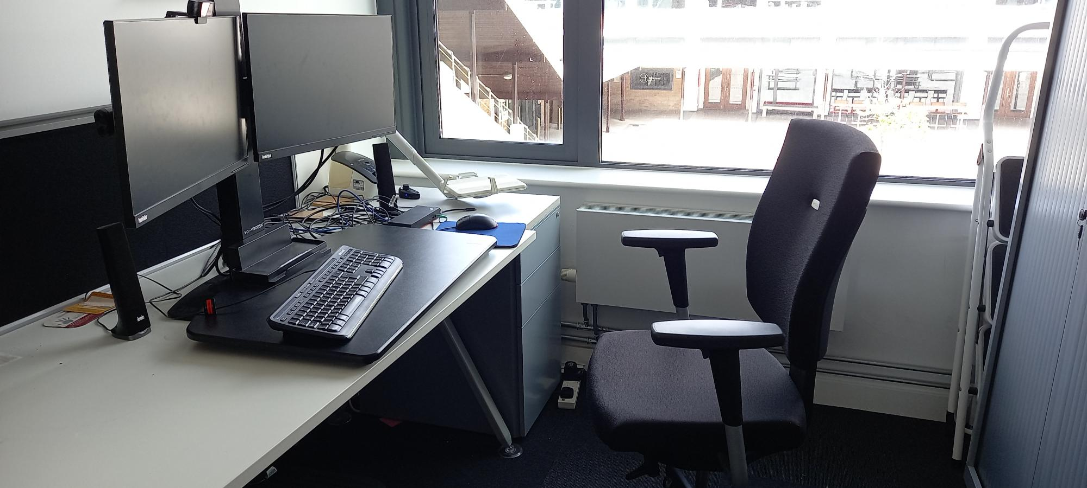
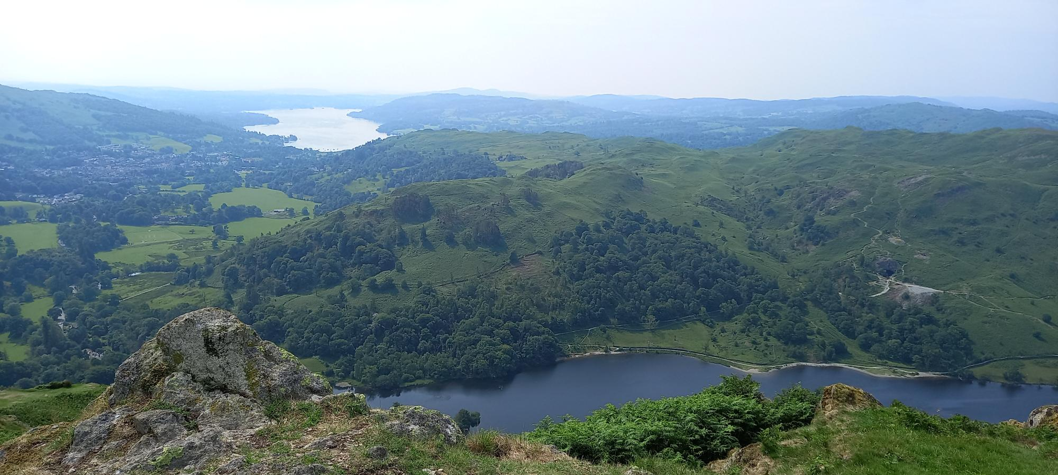
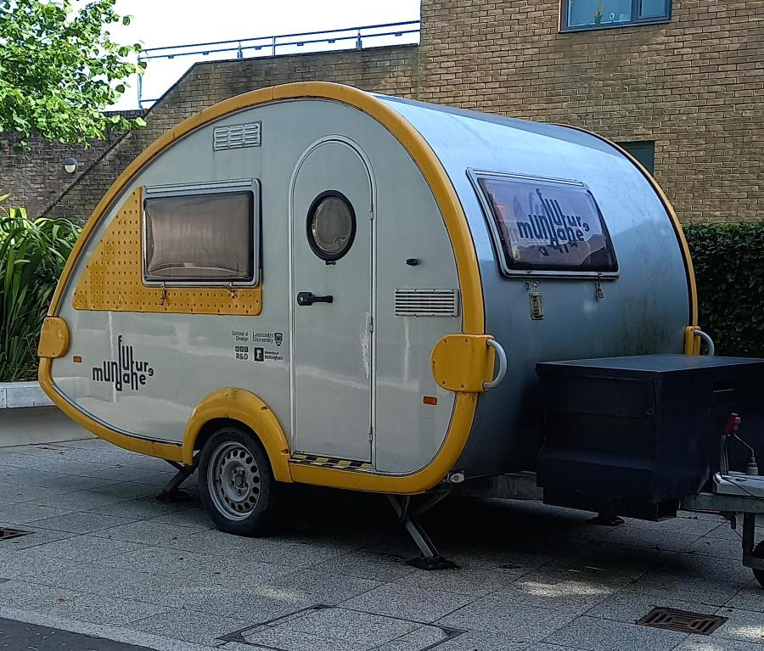
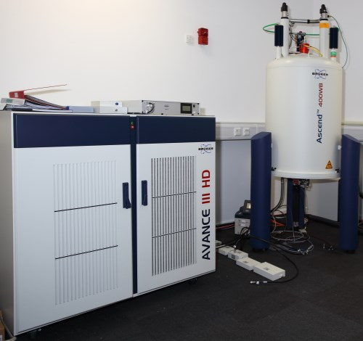
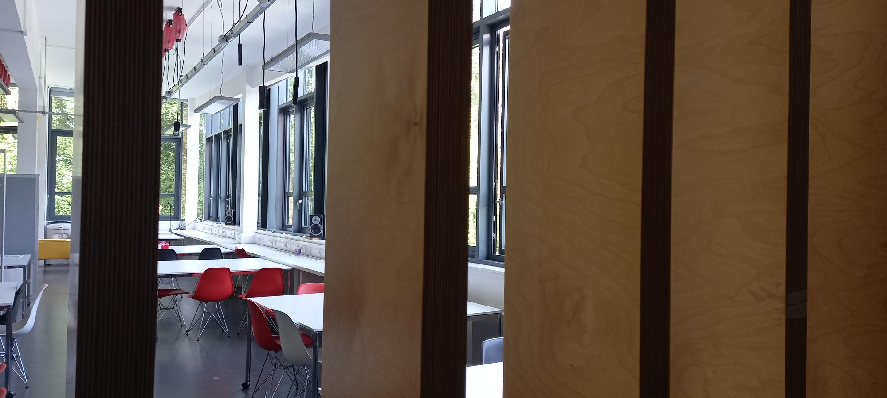
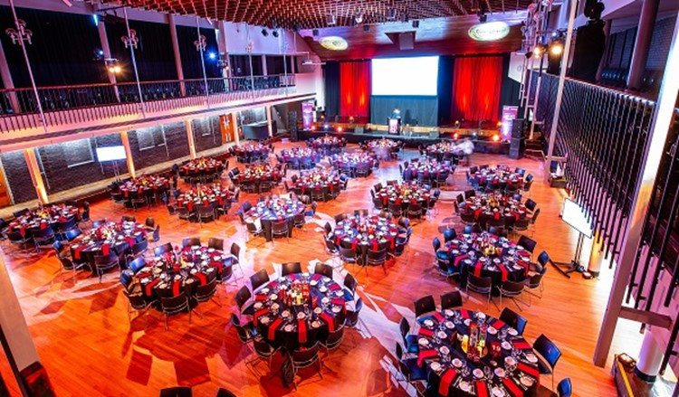
Research Spaces
Office
Field
Lab/Studio
Collaborations and Conferences
Did you know?
Our campus is used as a living lab for real-world research.
Notes:
Research takes place in different spaces, and we need to consider how to use space efficiently and sustainably. This can mean reorganising and sharing space within a room or department. Research takes place in offices and archives, scientific labs and design studios, in community spaces, sites of geological interest, and more. Research also takes place through collaboration with research partners, such as national facilities, and conferences play an important role for networking and dissemination.
Sustainability considerations:
General:
Lighting, heating, AC
Central provision, Standalone equipment
Water for cleaning, hand washing
Office:
Computer-based tasks – computer power, standby mode, internet use.
Lifecycle of equipment
Furniture
Lab / studio:
Equipment energy use – cold storage, fume cupboards, biosafety cabinets, ovens
Energy-use, resource-use and emissions associated with manufacturing and delivering the equipment
Energy use, resources, and emissions from your experiment
Water for cleaning equipment, dishwashers
Waste from consumables and samples that are no longer required
Field (outside sites, community sites, archives etc.):
Water for cleaning equipment
Energy use of equipment (battery powered?)
Travel
Waste from consumables and unwanted samples
Collaborations and Conferences:
Food and travel choices

Slide 29
Accreditation of Research Spaces (1)
LEAF: wet labs (that meet the criteria)
Green DiSC: for groups that use computation in their research
Green Impact: have an alternative to LEAF
My Green Lab: alternative to LEAF
ISO standards: ISO 14001 Environmental Management System (University operations)
Did you know?
Some funding bodies require research labs to be accredited.
Notes:
There are several accreditation schemes available for research spaces. LEAF and Green DiSC are the main ones in use at Lancaster University. You may come across others at partner labs/national facilities. For other research spaces you may need to show funders and interested parties that steps have been taken.

Slide 30
Accreditation of Research Spaces (2)
LEAF LEAF - Laboratory Efficiency Assessment Framework | Sustainable UCL
Green DiSC Green DiSC: a Digital Sustainability Certification | Software Sustainability Institute
Green Impact Green Impact | Students Organising for Sustainability
My Green Lab My Green Lab - My Green Lab
ISO standards ISO - International Organization for Standardization
Did you know?
Some funding bodies require research labs to be accredited.
Notes:
There are several accreditation schemes available for research spaces.

Slide 31
Funder strategies and requirements
UKRI
Environmental sustainability – UKRI
Wellcome
Environmental sustainability funding policy - Funding Guidance | Wellcome
“Laboratories should achieve the minimum level of accreditation offered by LEAF, My Green Lab or equivalent by the end of 2025.” (a higher level of accreditation will be expected in the future)
“Desk, field, clinical, and other researchers: should use a tool appropriate to their setting to assess the environmental impact of their work and to track their efforts to reduce it.”
Cancer Research UK
Environmental sustainability in research | Cancer Research UK
“hold the Laboratory Efficiency Assessment Framework (LEAF) or My Green Lab Certification at the Silver level, or an equivalent scheme for their research group(s) at the time of submission”
Checked July 2025

Slide 32
Sharing Research Equipment
Lancaster University
High End Computing (HEC) High End Computing | ASK - Lancaster University
Data Immersion Suite Data Immersion Suite | ASK - Lancaster University
Science and Technology Research Facilities - Lancaster University
Examples of institutes, facilities and equipment partnerships:
EPSRC Find an EPSRC facility or resource – UKRI
ITSS Showcase - UK ITSS
N8 N8 Research Partnership, N8 Equipment
Henry Royce Home - Henry Royce Institute

Slide 33
“Ten simple rules to make your research more sustainable”
Rule 1: Cherry-picking is allowed
Rule 2: Be informed
Rule 3: Prefer train over plane
Rule 4: Take advantage of remote participation
Rule 5: Work collectively and reproducibly
Rule 6: Encourage bottom-up sustainable initiatives
Rule 7: Evaluate the impact of your research practices
Rule 8: Ask sustainability research questions
Rule 9: Transfer ecofriendly gestures from home to the lab
Rule 10: Raise awareness
Ligozat A-L, Névéol A, Daly B, Frenoux E (2020) Ten simple rules to make your research more sustainable. PLoS Comput Biol 16(9): e1008148. https://doi.org/10.1371/journal.pcbi.1008148

Slide 34

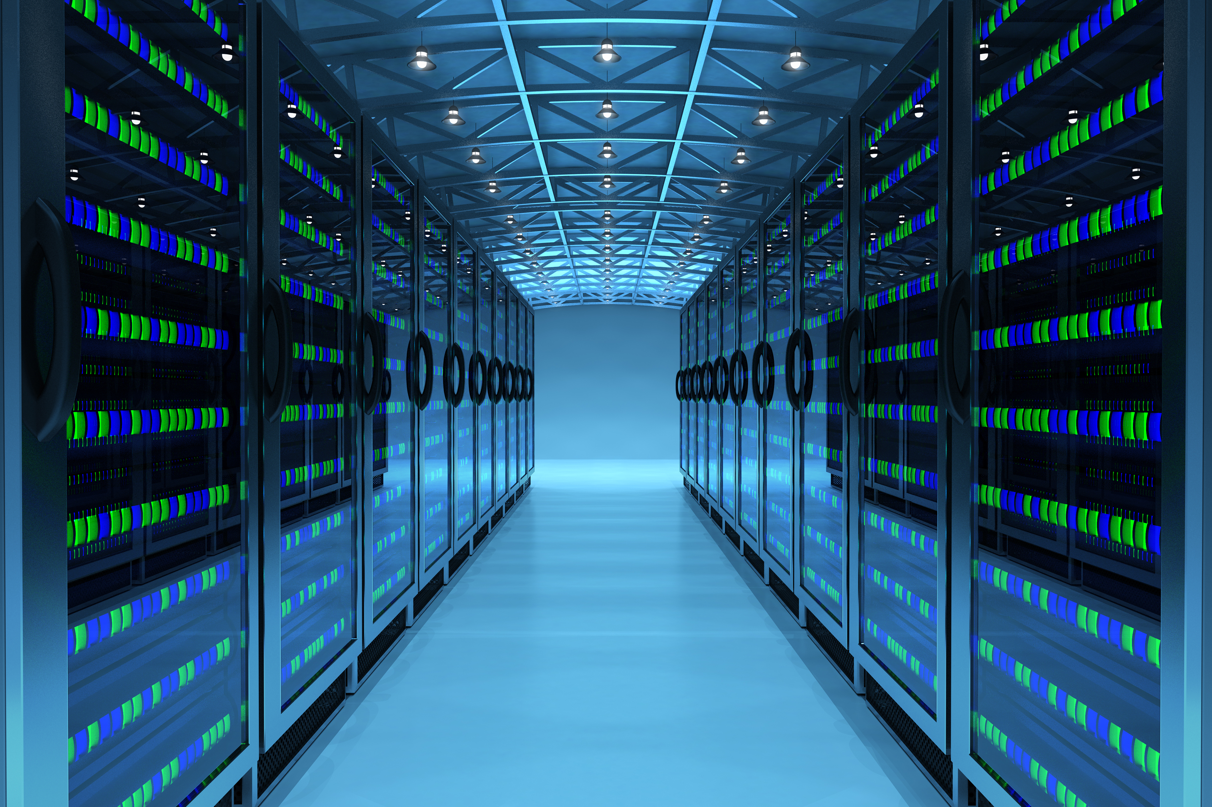

Digital Infrastructure
Reuse & Extend the Life of Hardware
Estimate carbon footprint of your code
Where is your computing performed? How clean is the energy?
print(“Hello world”)
Did you know?
A 2020 study estimated that an Australian astronomer's supercomputer usage produced 4x the CO₂e of their air travel.
Notes:
We will now look at some themes impacting sustainable research practice.
With a snapshot of ideas and considerations.

Slide 35
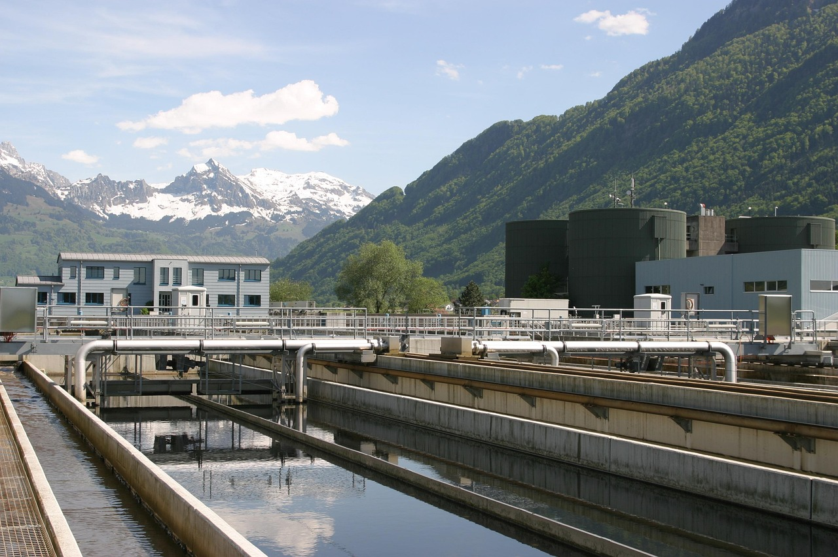
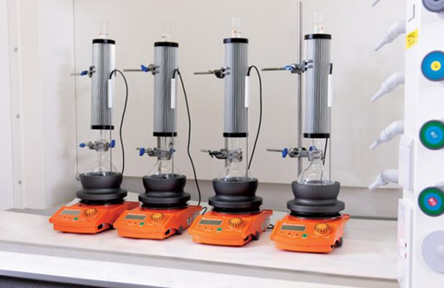

Resources: Water
Responsible use
Report leaks
Switch or retro fit
Placeholder figures
Helpdesk - Lancaster University
Did you know?
It can take 3 L to prepare 1 L of purified water.
Notes:
Water use is tied into carbon emissions. Energy is used to treat and transport to the taps – this process is then repeated as wastewater is then treated, transported…
How we provide clean water | United Utilities
In 2025 the NorthWest experienced drought after the driest start to spring in 69 years, and rain was insufficient to reverse. River flows declined, groundwater levels lowered, and reservoirs were significantly lower than usual.
Whilst droughts are part of natural weather patterns, climate change and our growing use of water can lead to water shortages and environmental damage.
Every drop counts. A tap that drips 30 ml of water every minute can waste 15,768 litres of water a year, and is a flooding risk. (How much is that drip really costing you?)
Some equipment that uses a continuous flow water can be switched for alternatives or used with a recirculating pump.

Slide 36
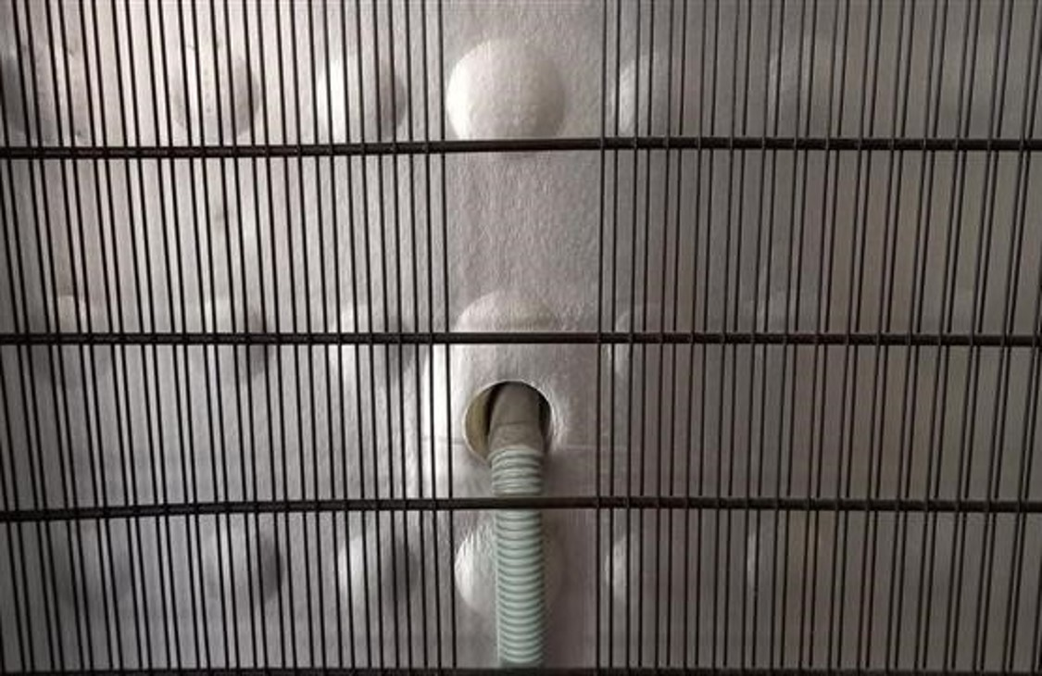
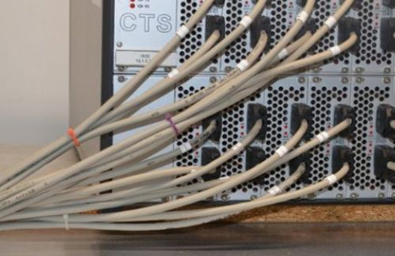

Resources: Energy
Equipment settings (e.g., freezer temperature)
End of day routine
Signage: what/when can equipment be turned off?
Placeholder figures
Did you know?
Standby mode still uses significant energy.
Notes:
Equipment settings:
For research sometimes specific (possibly extreme) temperature settings are required for an experiment or to maintain equipment, for example ultra low temperature physics, variable temperature studies in chemistry, controlled environment plant growth rooms in LEC.
In the general management of equipment, it maybe possible to change the settings to save energy whilst still providing a suitable environment. For example, where consumables and samples are stored in fridges and freezers, by changing a freezer setting from -80°C to -70°C the energy usage is reduced by 25 to 30%.
As well as cold storage, efficient operation of fume cupboards, and biosafety cabinets is needed.
End of day routine:
Good habits such as an end of day routine to ensure equipment that can be turned off has been.
Signage:
Whilst it is important to turn off equipment that is not in use to save energy, it is also important not to turn off equipment that is in use (e.g., multi day experiment). Signage such as overnight safety forms detailing the in-use dates, and labelling on plugs for equipment such as freezers, can optimise management whilst avoiding conflict.

Slide 37
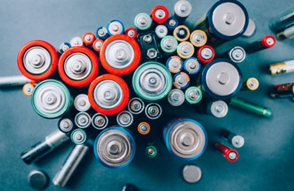


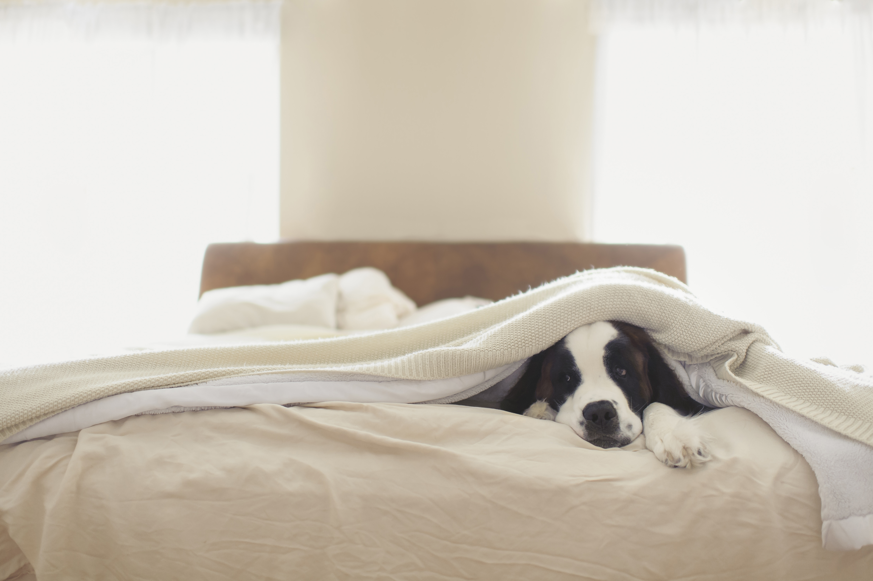


Waste
Waste routes
COSHH and standard operating procedures
Signage and Individual Behaviour
Did you know?
Some recycling schemes only recycle specific brands.
Notes:
It is important that waste is sorted correctly so that materials that can be are recovered and only minimal waste goes to the landfill/incinerator. Something you identify as waste from your work may be a resource for someone else’s research.
For those working with chemicals the waste stream needs to be identified before you use them.
Signage and individual behaviour contribute to how well waste management is actioned.

Slide 38
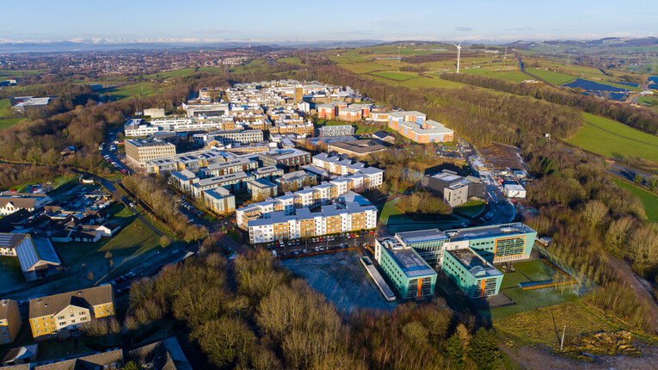

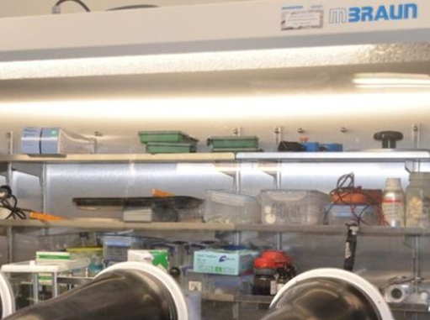



Recording and Reporting
Local / Wider
Quantitative and Qualitative
Equipment logs/ Inventories
Placeholder figures
When did you last have a lab or cupboard clear out?
Notes:
Whilst main reporting may be done at an institutional level, you can share and seek sustainable actions through your research networks and conferences.
Both quantitative and qualitative data is important to capture as not all actions can be readily recorded numerically.
Maintaining consumable inventories means that you buy what you need and avoid duplication. Equipment logs enable you to review usage levels of equipment and to identify sharing opportunities.

Slide 39
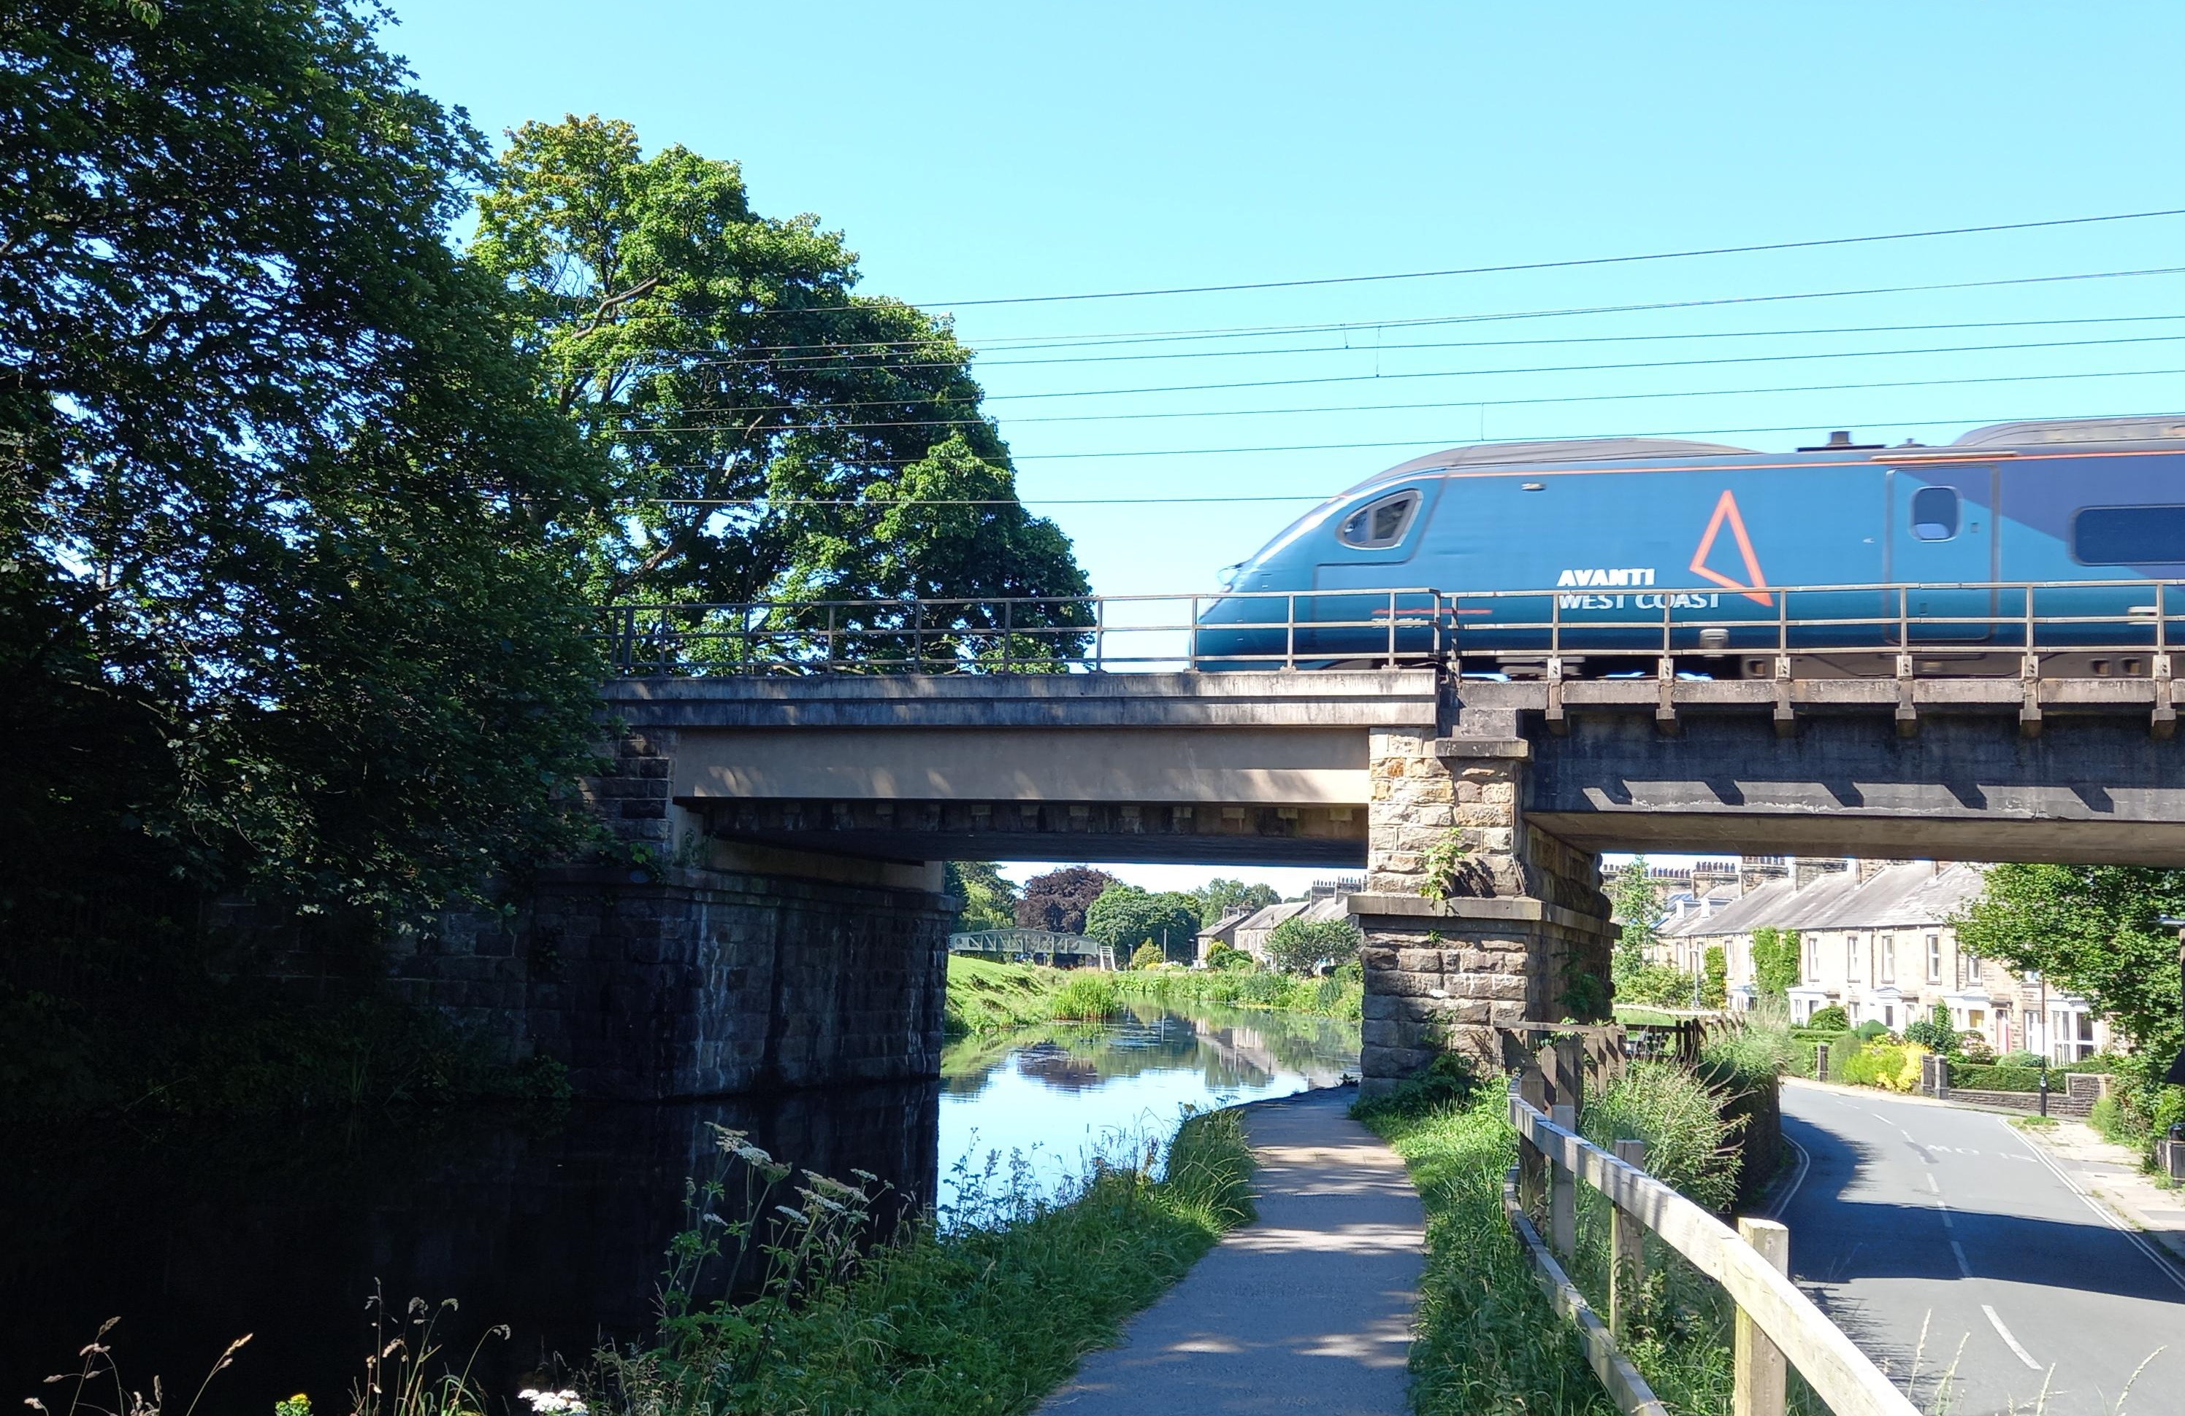
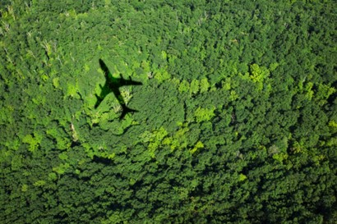

Travel
Train Travel
Decision Tree
Offsetting?
Decision Tree
Did you know?
Typically, train versus flying will reduce carbon emissions by 80-90%.
Notes:
Lastly, travel.
Train travel has reduced carbon emissions compared to flying and is preferred for UK and north Europe travel.
A decision tree is available to assist you in making travel choices: Decision Tree.
After other approaches to reduce or avoid carbon emission have been considered, as a last resort, it may be appropriate to consider a certified offsetting scheme.

Slide 40

Balancing Act
There are many considerations when deciding a course of action including:
Health and Safety
Budget/cost savings
Personal needs and work/life balance
Legislation
Institutional strategies
Notes:
Making decisions is a balancing act of different considerations.

Slide 41



Benefits of sustainable research practice
Protect and promote the environment.
Efficiency by developing a good methodology:
Resource management leading to less waste.
Time and money savings.
Skills development for careers.
Formation of collaborations through advocacy.
Notes:
Improved efficiency. If you put more effort into developing good methodology, this leads to less mistakes, less wasted time and money, and less wasted resources.

Slide 42
Lancaster Stories
Refuse
Reduce
Reuse/Repair
Repurpose
Recycle
As you listen to the stories can you identify links to any of the 5Rs?

Slide 43

Travel Story
Notes:
We will now look at some examples of actions that have been taken by researchers at Lancaster University.
Business travel is a significant sustainability challenge.
Challenges can include funding for low carbon methods and time available for the journey.
Flying indirect
Cameron Patterson an Early Career Researcher from Physics needed to go to San Francisco for a vital conference so instead of flying direct, he flew to Ottawa, Canada and got the train across USA to San Franscisco, stopping twice in Chicago and Denver to do physics talks and meet other researchers. He funded the trip by writing for a physics magazine about the travel journey and the Global Advancement Fund from the University.
Cameron Patterson, Cameron Patterson: Riding the rails to AGU, Astronomy & Geophysics, Volume 64(1), Feb 2023 https://doi.org/10.1093/astrogeo/atac096
Cameron Patterson, What a way to AGU, Astronomy & Geophysics, Volume 64(2), Apr 2023 https://doi.org/10.1093/astrogeo/atad016
Cameron Patterson, Travelling in style to AGU, Astronomy & Geophysics, Volume 64(4), Aug 2023 https://doi.org/10.1093/astrogeo/atad030

Slide 44

Collaboration Story
Notes:
A researcher in the School of Global Affairs is creating on-the-ground teams to do field work to limit long haul travel.

Slide 45
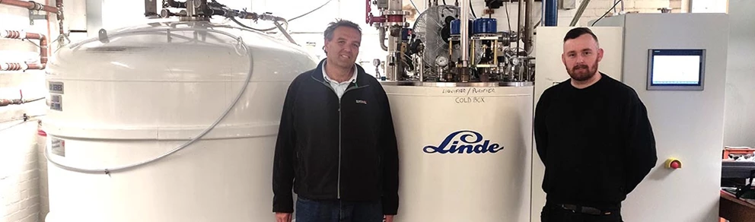
Procurement Story
News Item - greener cryo refrigeration for lancasters chemistry and physics research | Staff Intranet
Notes:
The physics department has a helium liquefaction plant, which is used by facilities at the ultralow temperature laboratory in the Physics department as well as at the Nuclear Magnetic Resonance Centre in the Chemistry Department.
Recycling: Helium is a non-renewable resource, and thanks to having an on-site liquefier plant, Lancaster University is able to achieve a 96% recycling rate through a recovery system.
Resource security: The external supply of liquid helium has been sporadic in recent times and disruption in helium supply would stall research for several months.
Reduction in electricity use: A major upgrade (funded by Research England in 2023) will save 100 MWh of electricity per year.

Slide 46
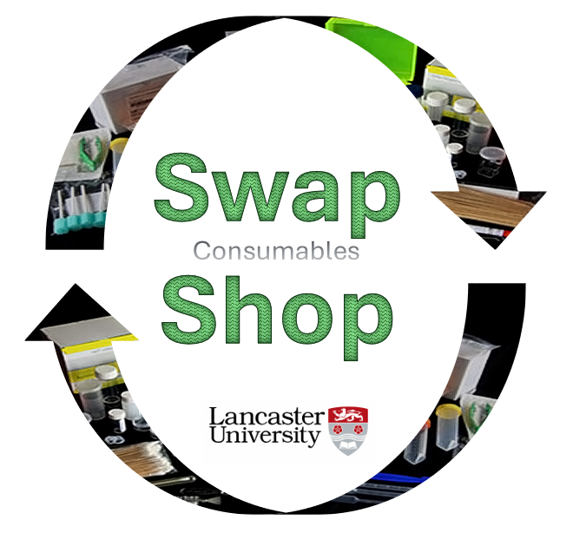
Consumables Swap Shop Story
Notes:
In 2025 LU Technicians started a swap shop for consumables.
Opportunity to exchange surplus items for items of need.
Unused or surplus items, such as plastic and glassware, and single use supplies, were collected and redistributed.
This included 900 items which transferred from LEC to Engineering.

Slide 47

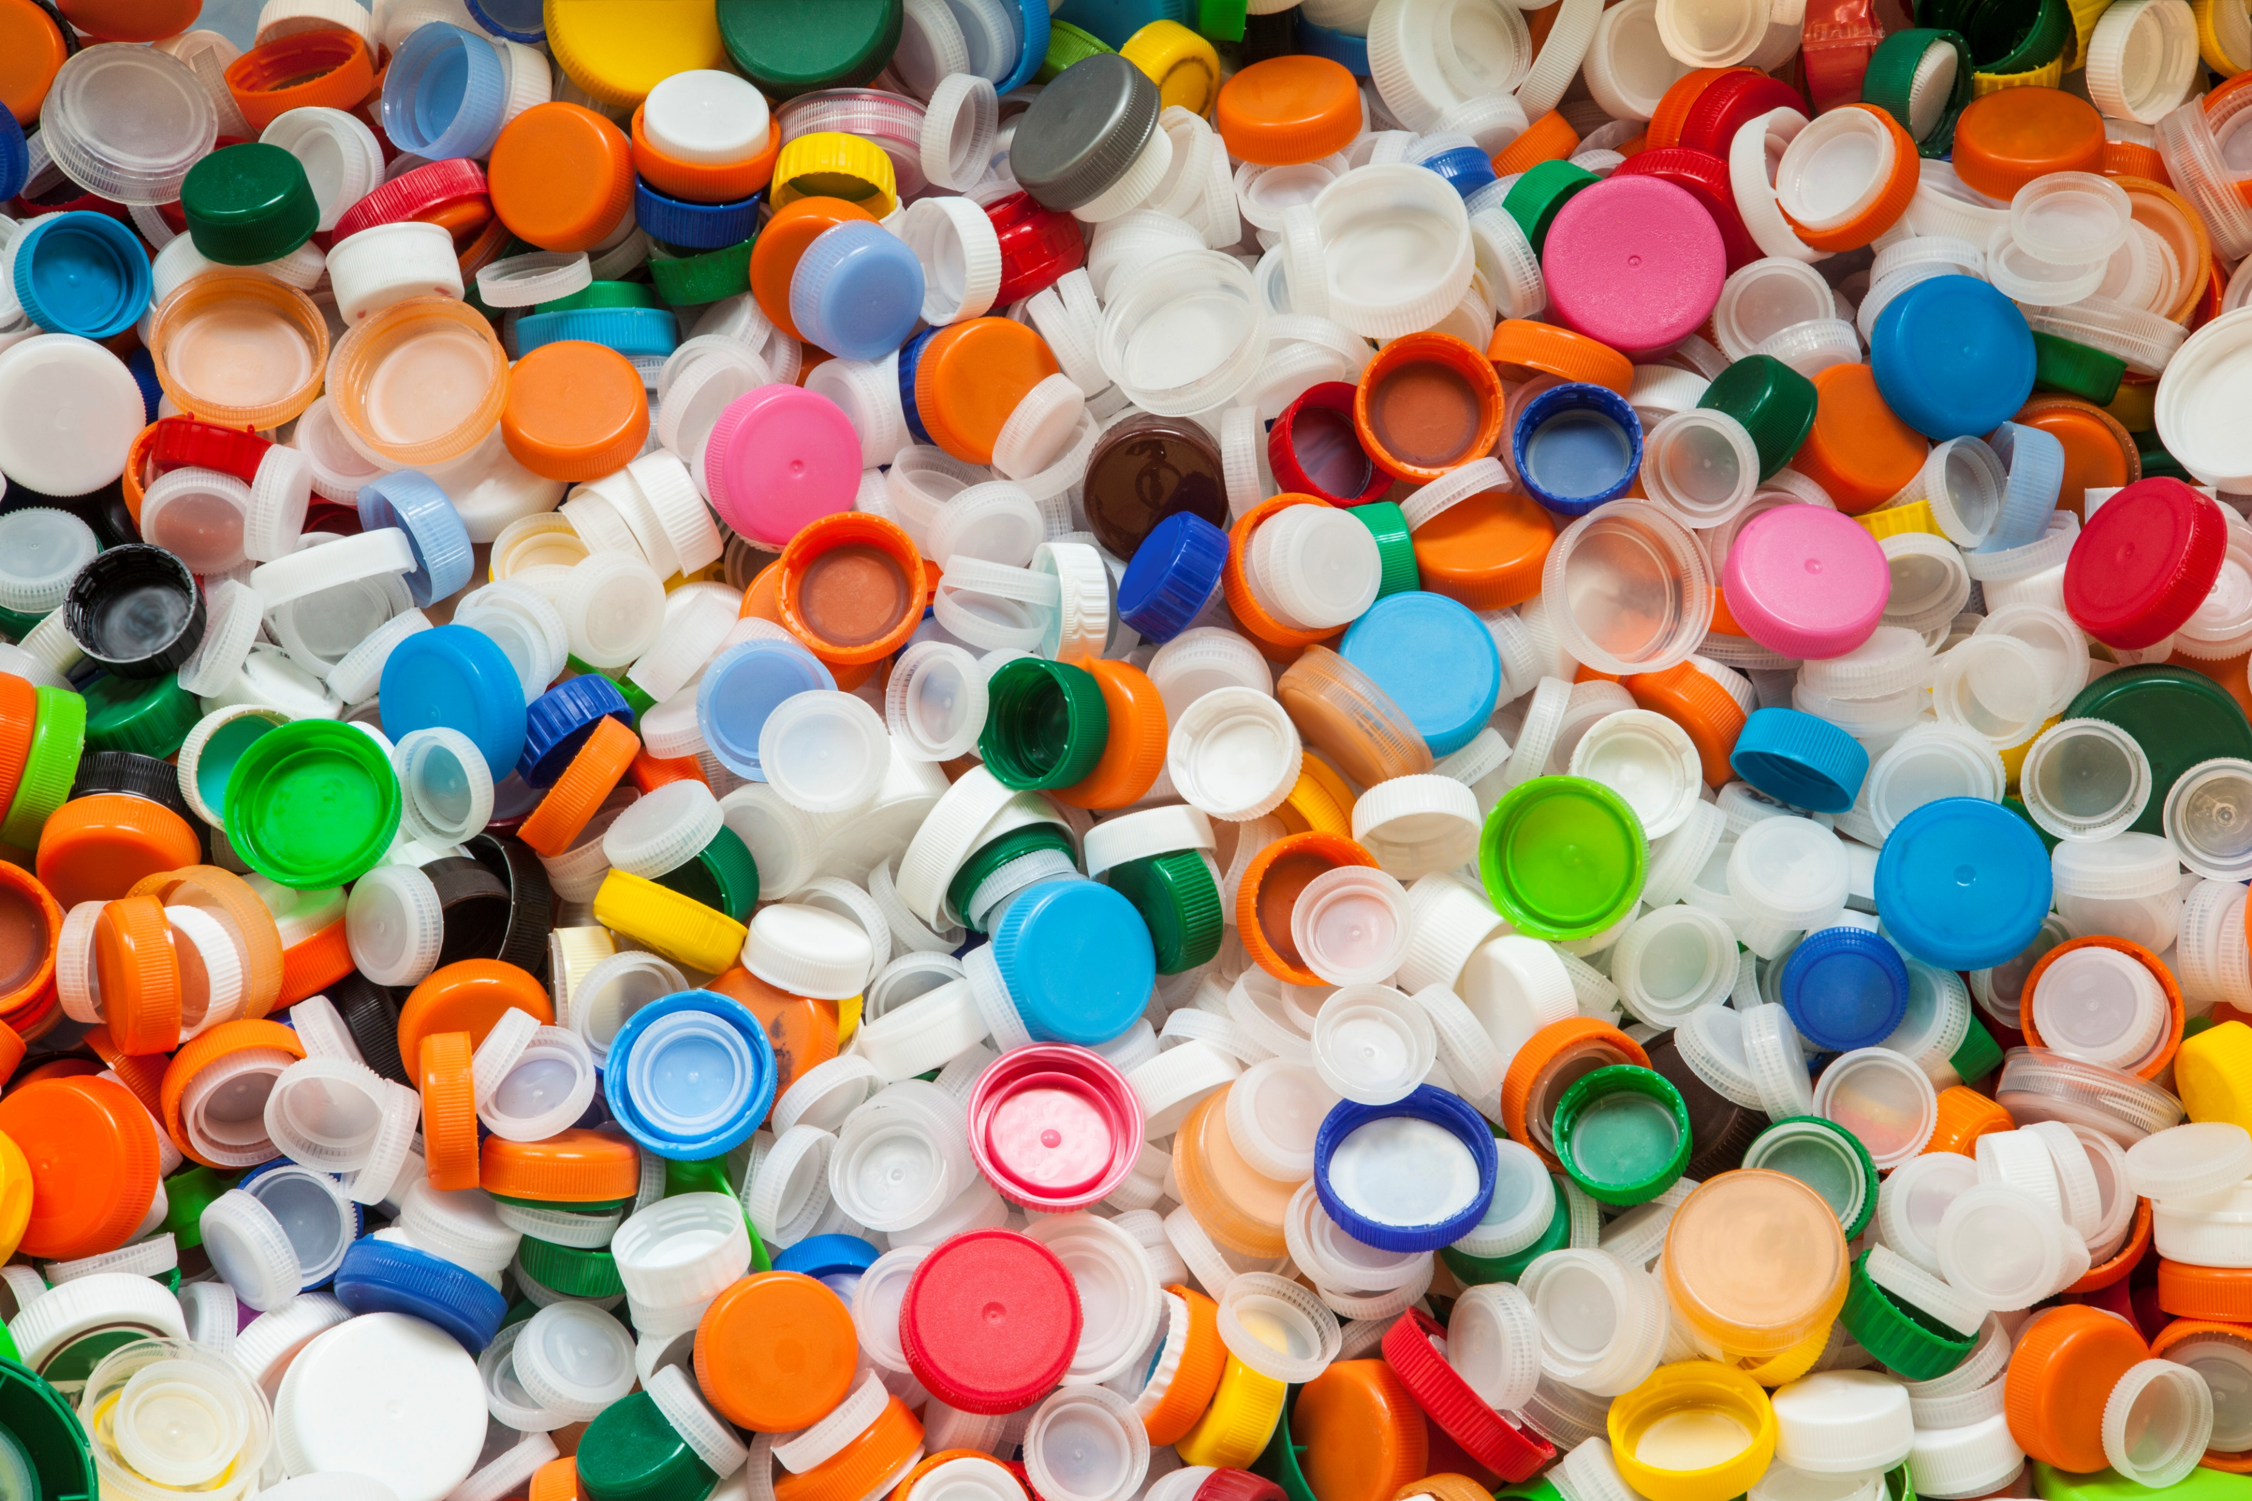
Research Themes
Pentland Centre
Plastic Packaging in People’s Lives
Pentland Centre - Lancaster University
Plastic Packaging in People's Lives - Lancaster University
Notes:
Sustainability may take centre stage as the theme of the research.
The Pentland Centre for Sustainability in Business
A network of research, teaching and professional services colleagues.
Based in LUMES, work to advance sustainability
Share sustainability through a Podcast – transforming Tomorrow
Plastic Packaging in People’s Lives
This was a 3-and-a-half-year project.
A holistic approach to rethink consumer behaviour around plastic packaging.

Slide 48

Planetary Health Report Card (Medicine)
Planetary Health Report Card
Notes:
The healthcare industry has a large environmental footprint (e.g., single use plastics, incinerators).
Med School
The Report Card is a tool for assessing medical schools' efforts to improve their sustainability.
Much of the Planetary Health Report card concerns the curriculum, but there are some criteria that relate to research.
Such as: Interdisciplinary Research, accreditation of lab spaces.
In 2025 Lancaster University Medical School was graded an A− overall for Medicine, with an A for Interdisciplinary Research.

Slide 49
Interactive session: Scenarios (15 mins)
In small groups discuss one or more of the scenarios. What can you do and what barriers to the 5Rs might be present?
Then feedback to the main group.
Notes:
Facilitator notes: Scenarios at end of slide deck (58-78). Can be printed (double sided) when a have large group split into small groups. If have one small group can display on screen.

Slide 50
Interactive session: Share and Seek (10 mins)
Time is provided for you to share your existing sustainable research practices and discuss any challenges that you currently have.
Concordat Priority areas for delivery:
Leadership and system change
Sustainable infrastructure
Sustainable procurement
Emissions from business and academic travel
Collaborations and partnerships
Environmental impact and reporting data
Notes:
Facilitator notes: Time can be adjusted as needed. Participants may share their own practices during the previous scenarios session.

Slide 51
Interactive session: Advocacy and Action (5 mins)
In your context, where can you advocate for sustainable research practice?
Notes:
Facilitator notes: Can skip to next slide if pressed for time.

Slide 52
Where can you advocate for sustainable research practice?
Research group meetings and noticeboards
Department/Faculty sustainability committees (plus teaching, research, all staff meetings etc.)
Teaching (research skills, careers)
Conference posters and talks
Professional/Learned Society groups
Notes:
This could be locally in your research group or wider within the institution or your research field.

Slide 53



What will you do next?
What in your research will you try to change?
Are you inducting your staff/colleagues in sustainability?
Is sustainability a concern covered in your teaching?
If you are introducing/training on a method, are you thinking of its lifetime sustainability?

Slide 54
Next steps
Review and apply change
Consider current practices and future possibilities
Reflect and respect
Not everyone can do everything, but everyone can do something.
Sustainability can be complicated – every decision has a trade-off.
Engage and Advocate
Legal compliance is the bare minimum we should be achieving as a University. Our sphere of influence and responsibility for a more sustainable future is enormous.
Notes:
1) Review and apply change
2) Reflect and respect
3) Engage and Advocate

Slide 55
Support for sustainable research practice
Shifting funding landscape:
Consider including in large grant costings.
Small and medium grants may be available from organisations such as professional societies.
Examples of funding opportunities:
Royal Society of Chemistry Sustainable Laboratories Grant
European Molecular Biology Organisation (EMBO) EMBO Lab Sustainability Award – The EMBO communities – EMBO

Slide 56
Further reading and resources (1)
General
The Brundtland Report (1987): https://unesdoc.unesco.org/ark:/48223/pf0000075053
Glossary of terms: https://www.lancaster.ac.uk/media/lancaster-university/content-assets/documents/sustainability/GlossaryoftermsV2.pdf
A video about what a Circular Economy means: https://www.youtube.com/watch?v=X6HDcubgxRk
Stockholm Resilience Centre (and the SDG wedding cake): https://www.stockholmresilience.org/research/research-news/2016-06-14-how-food-connects-all-the-sdgs.html
UNESCO glossary (2010): Glossary of basic terminology on disaster risk reduction - UNESCO Digital Library
Explaining the nested model: https://www.iema.net/articles/wobbly-foundations-taking-a-nested-approach-to-sustainability?t=0
Sustainability exchange, EAUC: Sustainability in UK tertiary education | Sustainability Exchange

Slide 57
Further reading and resources (2)
Research
Ligozat AL, Névéol A, Daly B, Frenoux E., Ten simple rules to make your research more sustainable. PLoS Comput Biol. 2020 Sep 24;16(9): doi: 10.1371/journal.pcbi.1008148
Transforming Tomorrow Podcast, Pentland Centre: Transforming Tomorrow Podcast - Lancaster University
Sustainability Conversations podcast, York University: Sustainability conversations podcast - Sustainability, University of York

Slide 58
Further reading and resources (3)
Computing
The six domains of responsible computing, British Computer Society: Responsible computing | BCS
L. Hilty, Computing Efficiency, Sufficiency, and Self-sufficiency: A Model for Sustainability?, LIMITS 2015, First Workshop on Computing within Limits, USA, 2015
The Karlskrona Manifesto for Sustainability Design, The Karlskrona Manifesto for Sustainability Design
Engineering
Lessons from research and innovation: building sustainability into research programmes, Royal Academy of Engineering: building sustainability into research programmes

Slide 59
Further reading and resources (4)
Labs
Resources for sustainable laboratory practice, Royal Society of Chemistry: Resources to help your laboratory become more sustainable
The Twelve Principles of Green Chemistry poster, Compound Interest: The Twelve Principles of Green Chemistry: What it is, & Why it Matters
CHEM21 selection guide of classical- and less classical-solvents, Green Chem., 2016, 18, 288-296: CHEM21 selection guide of classical- and less classical-solvents - Green Chemistry (RSC Publishing); Correction: CHEM21 selection guide of classical- and less classical-solvents - Green Chemistry (RSC Publishing)
Medical and Health Sciences, and Life Sciences
Advancing environmentally sustainable health research: Research Sustainability | Report | Wellcome
Climate, health and sustainability, National Institute for Health and Care Research Climate, health and sustainability | NIHR
NHS Greener NHS » System progress

Slide 60
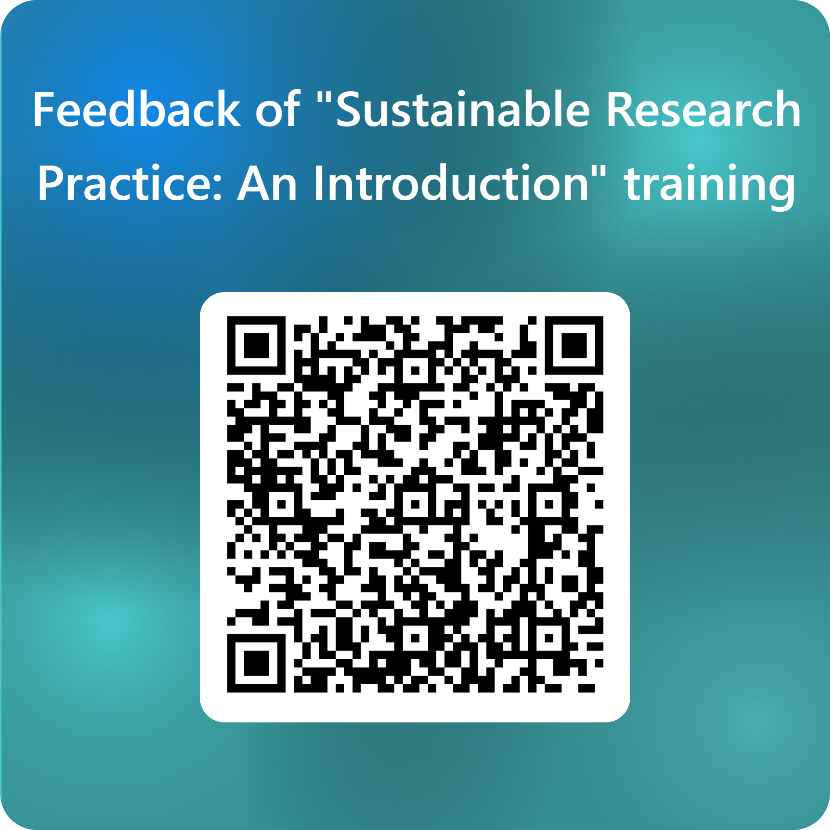
Evaluation
Please take a few minutes to complete this feedback form.
https://forms.office.com/e/EyuC9QVgmf

Slide 61
Thank you for attending

Slide 62
Scenario Cards and prompts
Notes:
Facilitator notes: Print without background onto pastel paper. 2 per group.
Designing Research
Delivering and Managing Research
Sharing Research

Slide 63
Designing a Research Project: costings (1)
You are preparing the costings for a research proposal. How might these be influenced by incorporating sustainable practices?
Designing Research

Slide 64
Designing a Research Project: costings (2) - prompts
Sustainable procurement may incur higher costs.
The need to purchase a higher-cost consumable to access a recycling scheme.
Travel and accommodation costs to access equipment at an alternative location rather than buying new equipment.
Service contracts to maintain equipment.
Low carbon travel, which may cost more.
Methodology design.

Slide 65
Designing a Research Project: methodology (1)
You are preparing the methodology for a research proposal. How might this be influenced by incorporating sustainable practices?
Designing Research

Slide 66
Designing a Research Project: methodology (2) - prompts
How is the research traditionally undertaken?
What are the challenges?
What are the opportunities?
Can you visit a test site or lab to learn about different equipment for alternative methods?

Slide 67
Managing Equipment (1)
A piece of equipment has broken and does not fit the current research needs of the research group.
To avoid it sitting in a corner gathering dust what actions can you take?
What about the equipment you do need and how can you keep it useable?
Delivering and Managing Research

Slide 68
Managing Equipment (2) - prompts
Broken and unneeded
Needed
Refurbish, Reuse, or Recycle.
Supplier/Manufacturer take back scheme for electrical equipment.
Upcycle.
Components may be useful spares for other researchers.
Review existing equipment in institution/networks.
Maintain usage logs to identify maintenance issues.
Upgrade existing equipment.
Purchase energy efficient equipment.
Share equipment.
Service contracts and longer warranties.
Repairability: availability of spare parts and know how.

Slide 69
Managing resources and waste (1)
You are participating in a meeting reviewing the “5Rs” for consumables. You have been allocated lead for recycling. What are your key points?
Delivering and Managing Research

Slide 70
Managing resources and waste (2) - prompts
Are the bins in the department labelled and being used correctly?
Is packaging recycled where possible? Are there different packaging options available at point of purchase?
Plastics.
Consumable recycling may be brand specific, e.g., gloves.
Chemical and sample management.
Solvent recycling. Upfront cost, then savings over time (for both procurement and waste disposal).

Slide 71
A Changing Environment: Drought (1)
The local area is in drought.
How could this affect the following research activities? What steps could be taken in response?
A research field of crops.
A study of water quality in the Lake District.
A lab experiment using water-cooled equipment.
An in-progress co-design project with local farmers examining land use.
Delivering and Managing Research

Slide 72
A Changing Environment: Drought (2) - prompts
Will research need to be abandoned or modified?
Have you built in adaptability to your project to respond to unforeseen events.
Do the environmental conditions form part of the research?
Can a recirculatory pump be used with the water-cooled equipment?
Can alternative equipment be used?

Slide 73
A Changing Environment: Flooding (1)
The local area has flooded impacting a substation, resulting in an unstable electricity supply.
How could this affect your research activities? What steps could be taken in response?
Delivering and Managing Research

Slide 74
A Changing Environment: Flooding (2) - prompts
Will research need to be abandoned, delayed or modified?
Have you built in adaptability to your project to respond to unforeseen events.
Back up power (diesel?).
Case Study: Lancaster, Storm Desmond 2015
Learning from Lancaster’s power cuts | Lancaster University, Lancaster University News Archive, 2016
Living without electricity, Royal Academy of Engineering, 2016

Slide 75
In the Office (1)
Following the retirement of a colleague, you are setting up their old office ready for a new colleague.
What might have been left behind in the office? How will you deal with it?
What might you need to include in the induction process of the new colleague?
Delivering and Managing Research

Slide 76
In the Office (2) - prompts
Is there any IT equipment that can be repurposed?
Are there any old consumables that need to be dealt with?
Any miscellaneous waste to be sorted for appropriate waste streams?
Is any of the furniture surplus or is additional furniture required?
What is included in your department’s induction processes. Have the following been shared?
How to report building and facility issues.
Location of recycling bins.
How to deal with IT waste (Waste Electric and Electronic Equipment (WEEE) Regulations).

Slide 77
Heading Out of Office (1)
Research off campus.
Your project involves fieldwork which takes place off campus (e.g., community based or at a site of geological interest). What are the different considerations for fieldwork in the UK or abroad?
Going on annual leave.
You have set your out-of-office auto reply and are leaving the office for a holiday. What actions will you take before leaving the office?
Delivering and Managing Research

Slide 78
Heading Out of Office (2) - prompts
1) Fieldwork
UK:
What sustainable travel options are available considering the equipment you need to take?
Abroad:
Are there local partners that you can work with? Can you combine it with other research/personal activities?
2) Annual leave
Have you added University closure dates to your calendar so that you can plan ahead for turning off equipment?
Is it clear which electrical equipment can be turned off and which needs to be kept on? For example, lab fridges and ovens.
Can you turn off your computer at the mains plug?
Whilst some lights are on sensors, and heating may be centrally controlled, have you turned off any desk lamps or personal heaters?

Slide 79
Attending a conference (1)
A non-established researcher has a choice of attending a conference in person or online. What are the pros and cons of each option?
Sharing Research

Slide 80
Attending a conference (2) - prompts
Each option has different benefits and challenges for individuals
Travel.
Level of engagement.
Inclusion.
Networking and collaboration.
Cost of attendance.
Interaction with vendors.
Lancaster University Travel Decision Tree. Services - Sustainable Business Travel | Staff Intranet

Slide 81
Running a conference (1)
You are part of a team planning a conference, which you aim to be both inclusive and sustainable.
What factors will use consider in your planning?
How could you promote sustainability at the conference?
Sharing Research

Slide 82
Running a conference (2) - prompts
Attendance mode: Conference attendance may be online, in person or hybrid.
Lancaster University Travel Decision Tree. Services - Sustainable Business Travel | Staff Intranet
For online/hybrid mode look for good practice guidance.
Travel guidance for attendees.
Food choices or bring your own.
Bring your own device to minimise printing, but print for those who request at registration.
Joined up approaches. Run back-to-back with another event.
Support networking with local institutions.
Provide hot desking space.
What have previous attendees' experiences been?

Slide 83
Other activities
These activities can be used to further your exploration of sustainable practice.

Slide 84
Travel Itinerary
Choose a destination.
Review the Lancaster University travel decision tree. Sustainable Business Travel guidance can be found via this link: Services | Staff Intranet
Explore ways to travel there using low carbon methods.

Slide 85
Design a sign or label (1)
Example of designing clear signage: The Olympics and Paralympics
They had a challenge in providing additional direction signage in cities, such as Paris and London, which already have a lot of signage. Pink was an effective colour choice.
Behind the scenes of the signage for the Paris 2024 Olympic and Paralympic Games
London Olympics… wayfinding. helping you find your way using colour
Sign; London 2012 Olympics and Paralympics sign showing dates and advice, 2012 | London Transport Museum

Slide 86

Design a sign or label (2)
Task
Review the colour palette of signage in your department.
Note that the colours of health and safety signs are an important aspect of emphasising their meaning.
Can you select a colour and layout for sustainability messaging?

